Slide 1
SwitchV: Automated SDN Switch Validation with P4 Models
Kinan Dak Albab, Jonathan DiLorenzo, Stefan Heule, Ali Kheradmand, Steffen Smolka, Konstantin Weitz, Muhammad Timarzi, Jiaqi Gao, Minlan Yu
SIGCOMM 2022

Slide 2



Background and Motivation
How to guarantee the reliability of running programs?
Challenges
The controller, the switch software stack, and the switch hardware and drivers are typically developed by different teams across several companies.
Increasing feature velocity
The success of network verification at catching configurations bugs may have reached a point of diminishing returns
Many network failures now incur due to hardware and software bugs

Slide 3
Background and Motivation
How to guarantee the reliability of running programs?
Validation vs Verification
Verification: find bugs in the configuration
Validation: find bugs in the switch, not in the configuration
Most of the recent work focuses on the network verification
End-to-End Switch Validation
Some work verify hardware designs, including switch hardware. But they cannot verify black box switches.

Slide 4
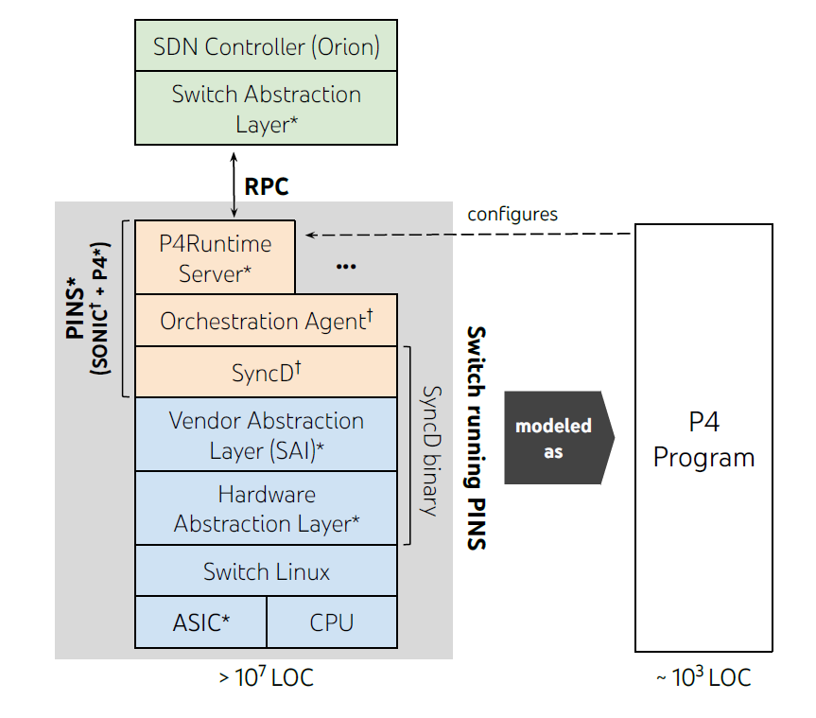
SwitchV
P4 at Google
switch.p4
modelled as
Fixed-function ASIC
PINS: P4 Integrated Network Stack
A fixed-function switch running PINS

Slide 5
SwitchV
Control plane API
Data plane
SDN controller
SDN controller
model as
Switch
switch.p4
PINS
Switch software stack
P4Runtime Server
Orchestration Agent
SyncD
Vendor Abstraction Layer (SAI)
ASIC drivers
Hardware Abstraction Layer
Switch Linux
ASIC
CPU

Slide 6
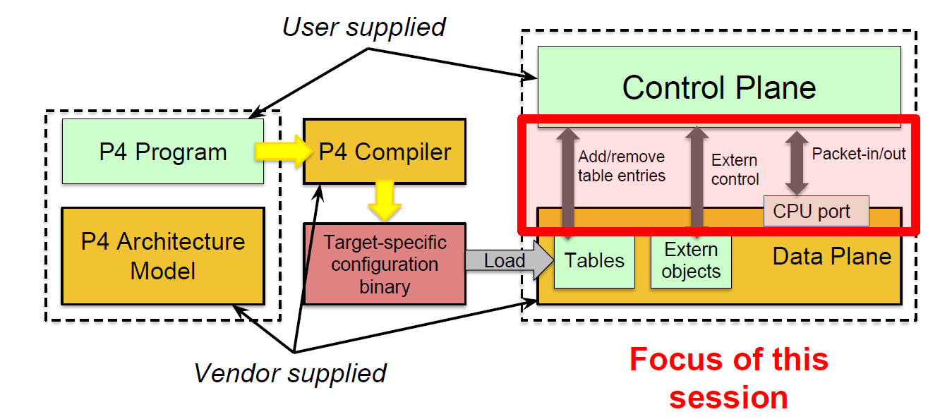
SwitchV
The interface exposed to the controller is governed by the P4Runtime Protocol

Slide 7
SwitchV
Control plane API
Data plane
SDN controller
P4-fuzzer: validate the control plane API
Generate a sequence of control plane requests (valid requests & invalid ones)
switch.p4
P4-symbolic: validate the data plane behavior
Generate test packets that satisfy the coverage assertations provides by test engineers
Hit every table entry
SwitchV provides a mechanism for judging whether the switch’s response was admissible or not

Slide 8
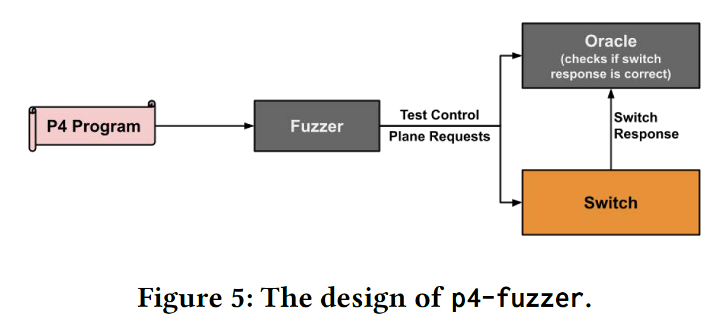
P4-fuzzer

Slide 9
P4-fuzzer
Generating valid requests
Generating invalid requests
Oracle
Determine if the switch behaves correctly

Slide 10
Valid requests
P4-fuzzer analyzes the existing tables in the input P4 program
Table types
Headers
Actions
P4-fuzzer generates control plane requests that violate no obvious rules in the P4Runtime specification.
Completeness?

Slide 11
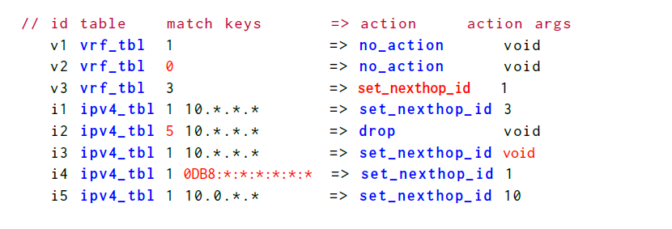
An example of table entries

Slide 12
In-valid requests
Naïve method
Randomly choosing values produces “uninteresting” requests
E.g., random table or action IDs
Easily detected, leave most of the deeper and more complex control space untested
Mutation-based approach
Apply a single mutation to a valid request

Slide 13
Invalid requests
Mutation-based approach
Single action tables
Valid requests
Valid table ID
An action ID permitted by the table
An appropriate number of arguments
One match field entry per each key in the table
Invalid requests
Modify a valid request to violate any one of the above properties

Slide 14
Invalid requests
Mutation-based approach
One-shot action selector programming
An entry can be mapped to a set of actions (by weight)
Assign a non-positive weight to an action
Other example of mutations
Duplicate existing entries
Delete non-existing ones
Requests refer to and thus depend on non-existing entries

Slide 15
P4-fuzzer

Slide 16
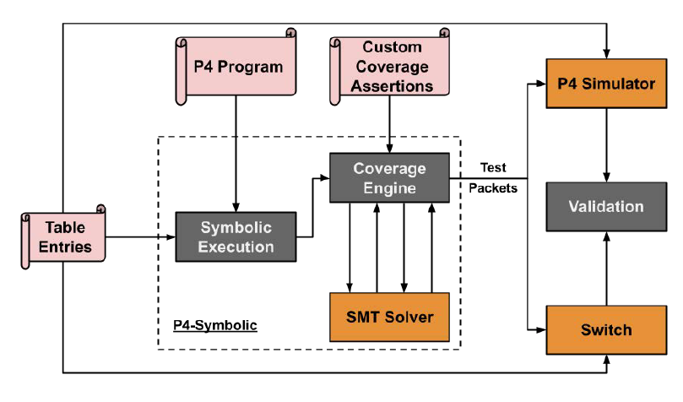
P4-symbolic

Slide 17
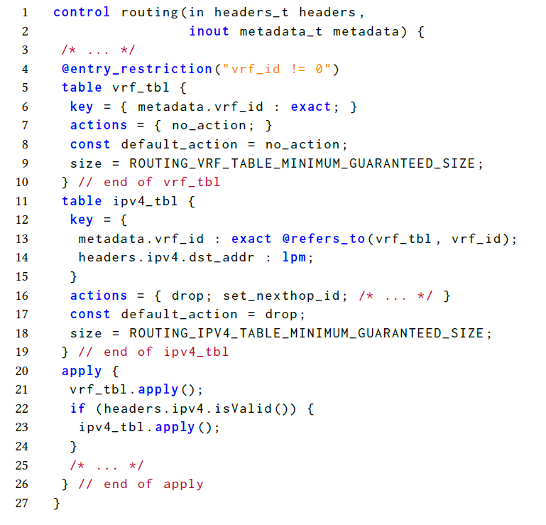

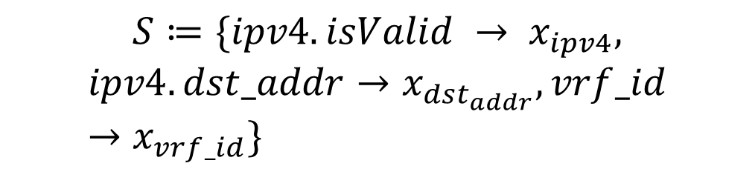
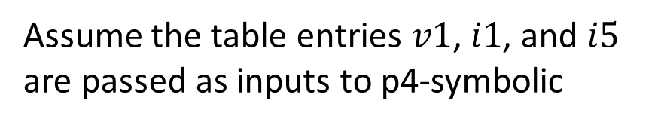
Example
Assume the table entries $v1$, $i1$, and $i5$ are passed as inputs to p4-symbolic
$$S≔\{ipv4.isValid → x_{ipv4},$$
$$ipv4.dst_addr→x_{dst_{addr}},vrf_id→x_{vrf_id}\}$$
$${C=(x}_{ipv4}=true)$$

Slide 18
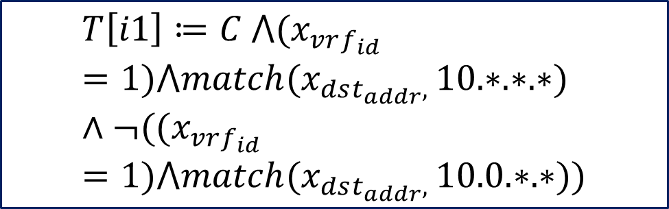
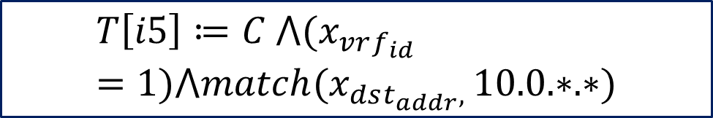
Example
Descending order of priority (longest prefix match)
$$T\left[i5\right]≔C ⋀(x_{vrf_{id}}=1)⋀match(x_{dst_{addr}, }10.0.∗.∗)$$
$$T\left[i1\right]≔C ⋀(x_{vrf_{id}}=1)⋀match(x_{dst_{addr}, }10.∗.∗.∗)∧¬((x_{vrf_{id}}=1)⋀match(x_{dst_{addr}, }10.0.∗.∗))$$

Slide 19
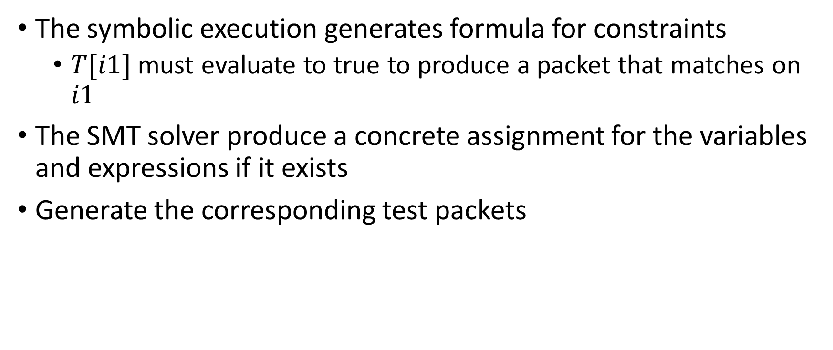
P4 symbolic
The symbolic execution generates formula for constraints
$T[i1]$ must evaluate to true to produce a packet that matches on $i1$
The SMT solver produce a concrete assignment for the variables and expressions if it exists
Generate the corresponding test packets

Slide 20
P4-symbolic
Table
entries
P4Runtime
P4 simulator
(BMv2)
Expected Output
Packets
p4-symbolic
Input
Packets
Verify Match
P4Runtime
Switch
Actual Output Packets
Software
Control plane
Data plane

Slide 21
Limitations
Do not support certain P4 constructs that are not used in their P4 programs
E.g., unions
Hashing
Exact hashing algorithm is unknown and may differ across switches
P4-symbolic interprets the hash as a free operation
The output of the hash is allowed to be any value
Use round-robin hashing
Runs the test packet through it several times (i.e., until the same behavior occurs twice)

Slide 22
Implementation
Deployed on Google’s data center
P4-fuzzer: 3.5k lines of code, p4-symbolic: 5k lines of code
Use SwitchV to validate two switch stacks
PINS
2.5 million lines of code
10 million lines of code when combined with the pre-existing layers on a switch
Cerberus

Slide 23
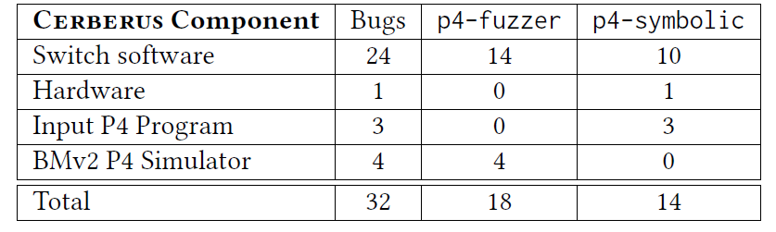
Detected bugs

Slide 24
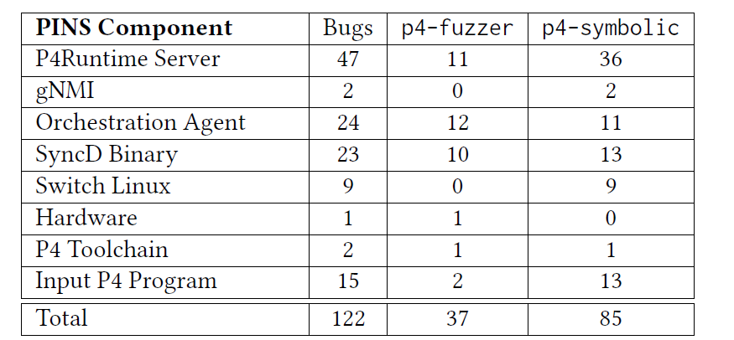
Detected bugs
A plurality of bugs were found in the new parts of the stacks under development

Slide 25
Detected bugs - examples
P4-symbolic
Send certain out packets back to the controller via the packet-in mechanism
The hardware dropped packets on a port with a certain port speed due to electric interference

Slide 26
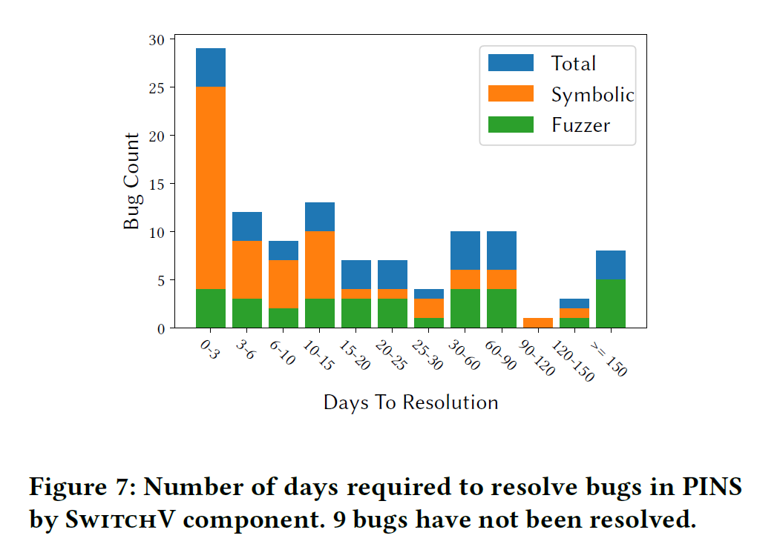
Detected bugs
Majority of bugs in PINS were fixed within 14 days, with 33% of bugs fixed with in 5 days (find important bugs)

Slide 27
Bug complexity
Devise trivial suite of tests
Set P4Info
Table entry programming
Read all tables
Read back all entries and compare them
Packet-in
Send a packet matches a previous ACL rule
Check the correct packet gets received
Packet-out
Packet forwarding

Slide 28
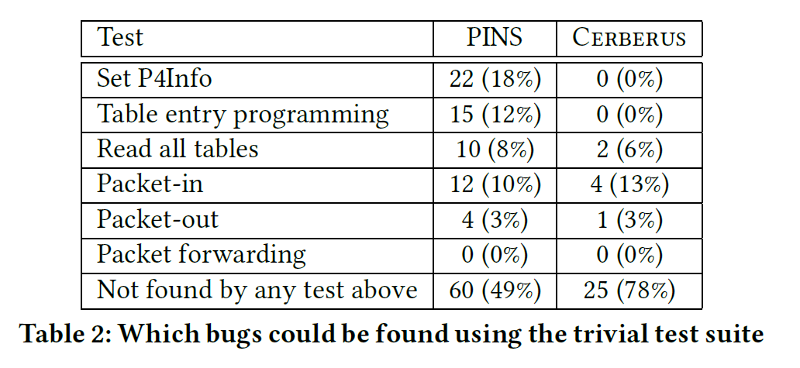
Bug complexity

Slide 29
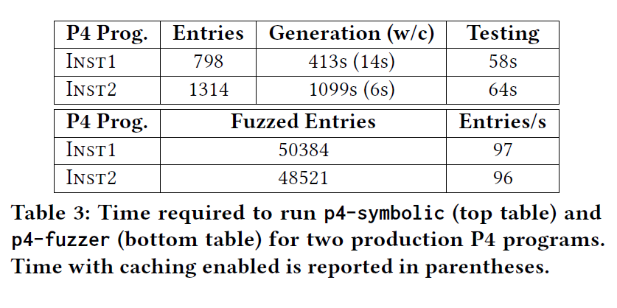
Performance of SwitchV
Run the generated packets through the switch and BMv2, and compare their behavior
P4-symbolic hits every reachable input table entries at least once

Slide 30
Conclusion and discussion
A new paradigm: specifications as Code
Tests evolve effortlessly with specification
Thoughts
How to guarantee the completeness of p4-fuzzer tests
How to label different types of bugs

